Slide 1
Chapter 16: number functions
2023

Slide 2
Chapter 16: number functions
Contents:
Ceiling function
Floor function
Round function
Cast function

Slide 3
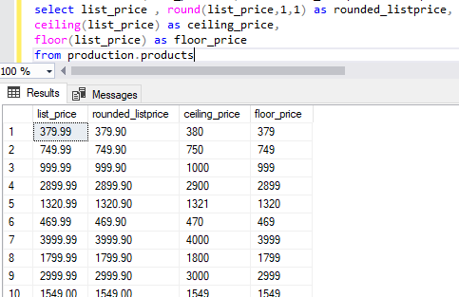
Ceiling and floor rounding
Floor() function returns the integer value less than or equal to the value passed in.
Ceiling() function on the other hand is the opposite. It returns the same data type as floor but returns the integer equal to or higher than the value passed in. See example below:

Slide 4
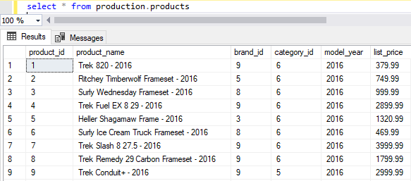
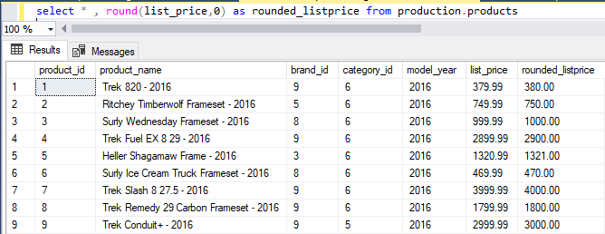
Round
The ROUND() function rounds a number or value to a specific number of decimal places that you wish.
Example: It has been rounded to 0 decimal. Pay attention to the red highlighted blocks.

Slide 5
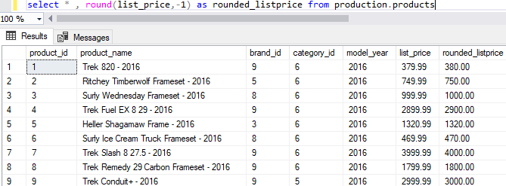
Round Continued
Round(value -1) round the value to the nearest tens
Round(value -2) round the value to the nearest hundreds
Round(value -3) round the value to the nearest thousands and you can move in that order.

Slide 6
Cast
The CAST() function returns the expression converted to the target data type.
The syntax:
CAST ( expression AS target_type[length])
In the above syntax:
1. The expression can be a literal value or a valid expression of any type that will be converted.
2. The target_type is the target data type to which you want to convert the expression.
Note that it cannot be an alias data type.
3. The length is an optional integer that specifies the length of the target type, eg varchar(20).
The length defaults to 30.
Notes:
When you use two values with different data types SQL Server will try to convert the lower data type to the higher one before it can process the calculation. This is known as an implicit conversion in SQL Server.
In contrast to implicit conversions we have explicit conversions where you call the CAST() function to explicitly convert a value of one type to another
Advanced
To use a date time formatted column only as the date part – That way it can have a date and time in the column but you re able to still group by date
SELECT
user_ext CAST(date_time AS DATE) COUNT(nrs_dialed)
FROM
tsr
GROUP BY user_ext CAST(date_time AS DATE)
ORDER BY user_ext CAST(date_time AS DATE);

Slide 7
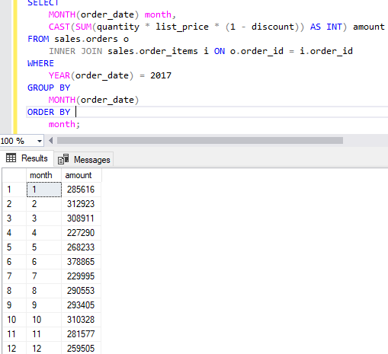
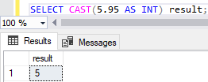
Cast example
CAST() function to convert the monthly sales in 2017 to integer values.

Slide 8
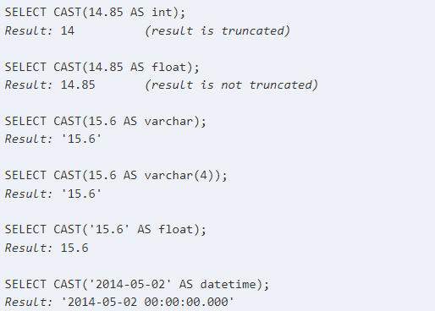
Cast examples

Slide 9
Round / Ceiling / Floor … functions
Round the following number 235.415 , to 2 decimal label it as RoundValue
Round the following number 748.58 , to the nearest thousand label it as RoundValue
Calculate the ceil value for the following number 25.75 label it ‘CeilValue’
Calculate the ceil value for the following number 43.1 label it ‘CeilValue’
Calculate the floor value for the following number 25.75 label it ‘FloorValue’
Calculate the floor value for the following number -13.5 label it ‘FloorValue’
Calculate the ceiling of the target column of the longitude data
AirBnB

Slide 10
Cast
Convert number of reviews into an integer.
AirBnB

